Slide 1
APPLICATION OF GEOSPATIAL TECHNIQUES IN URBAN PLANNING

Slide 2
Urbanization is an index of transformation from traditional rural economies to modern industrial one.
It is a progressive concentration of population in urban unit.
During the last fifty years the population of India has grown two and a half times, but urban India has increased nearly five times.
In 2001, 306.9 million Indians (30.5%) were living in nearly 3,700 towns and cities spread across the country, and it is expected to increase to over 400 million and 533 million by 2011 and 2021 respectively.
Remote sensing can provide an important source of data for urban area mapping and environmental monitoring.
Urban land cover/use mapping has received an increasing amount of attention from urban planners and scientists including geographers.
various techniques have been applied for mapping urban land use/land cover. It helps in encroaching urban problems even of very small magnitude and dire.

Slide 3
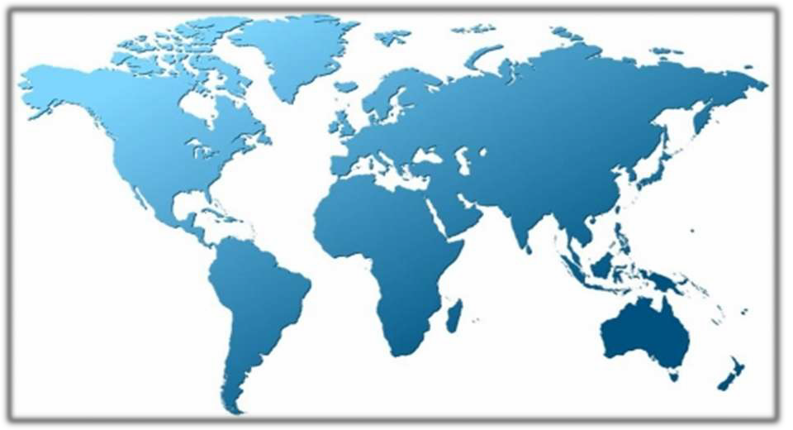
Investing in GIS
TECHNOLOGY
for better
Urban futures

Slide 4
Need for Geospatial techniques
Do you feel overwhelmed when making complex, data-driven decisions?
Do you have trouble communicating your insights to key policy-makers, funders, communities and constituents?
How can you find hidden spatial patterns in complicated decision-making scenarios? How can you analyze and visualize large amounts of quantitative data?
Geographic Information System (GIS) has the potential to help with all of these crucial and difficult activities.

Slide 5
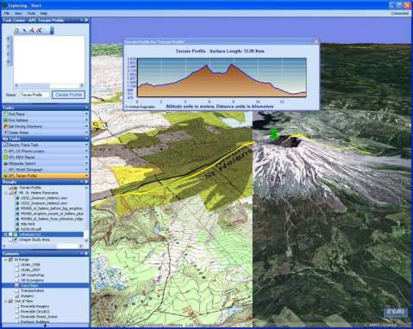
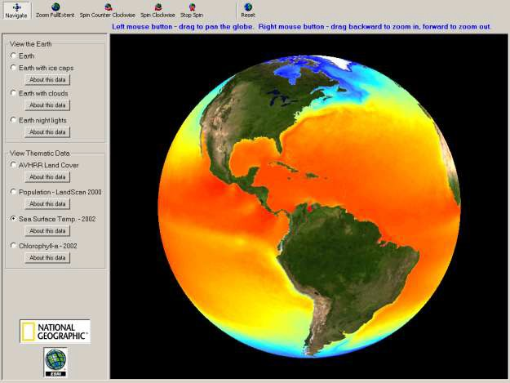
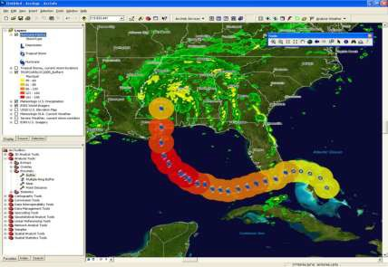
What is GIS

Slide 6
GIS and Remote Sensing
GIS - computer aided decision support and planning tool which integrates spatial data from maps and other auxiliary data (attribute data) for a geographical area of interest. Combines hardware, software and people to achieve its performance

Slide 7
GIS and Remote Sensing
Remote Sensing - use of high-resolution satellite imageries or aerial photographs to support urban planning and management activities.

Slide 8
GIS: A framework for understand and managing our earth

Slide 9
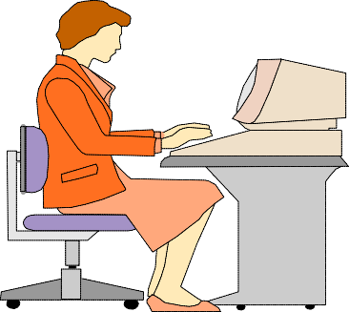
GIS integrates 5 components
People
GIS
Data
Analysis
A computer-based system for the storage, retrieval, manipulation, analysis, and display of geo-referenced spatial data.
As a system it consist of:
Hardware
Software

Slide 10
GIS functions
Store
Query
Capture
GIS
Analyze
Output
Display

Slide 11
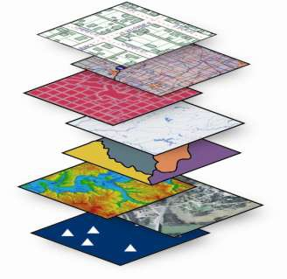
Geographical Information system is consists of
Remote Sensing (RS)
-Use of satellites or aircraft to capture information (land cover) about the earth’s surface
Global Positioning Systems (GPS)
- A system of earth-orbiting satellites which can provide precise (X,Y) Location on the earth’s surface
•Geographic Information Systems (GIS)
-Systems with capability for input, storage, manipulation/analysis and display of spatial information
GIS integrate Spatial (map data) and their non-spatial (attribute information) into one “system” that allows the user to interact with both aspects simultaneously.
It stores information about the world as a collection of thematic layers that are linked together through geo-referencing.
In a GIS, the maps have tables of data behind them (Spatial databases). This means when you combine different maps you combine data to get the information you need.

Slide 12
Study urban growth/sprawl and trend of growth
Updating and monitoring using repetitive coverage
Study of urban morphology, population estimation and other physical aspects of urban environment
Space use surveys in city centers
Slum detection, monitoring and updating
Study of transportation system and important aspects both in static and dynamic mode
Site suitability and catchments area analysis
Study of open/vacant space

Slide 13
Urban Land Use Classification Criteria
The classification system should be applicable over a large area covering both city core and its surroundings.
Classification should be suitable for using remotely sensed data obtained at different time periods
The minimum interpretation accuracy and reliability in the identification of land use should be about 85 percent subject to level of classification of different land uses.
The nomenclature, definition and framework to the extent possible should be compatible with existing terminologies adopted in planning agencies.
Classification should be easier to understand and flexible.
Aggregation of similar or multiple land use classes should be possible at different levels of requirement.
The classes must be mutually exclusive, i.e. any geographical individual can only fall into one class
Wherever possible, it must be based upon quantitative criteria

Slide 14
In this context, urban remote sensing must be able to provide planners with certain key, data sets that are pertinent to urban studies, notably:
The location and extent of urban areas.
(ii) The nature and spatial distribution of different land use categories within urban areas.
(iii) The primary transportation networks and related infrastructure.
(iv) Census related statistics and socio-economic indicators.
(v) The 3-D structure of urban areas for telecommunications (inter-visibility) and environmental Impact Assessment (EIA) studies.
(vi) The ability to monitor changes in these features over time and space.

Slide 15
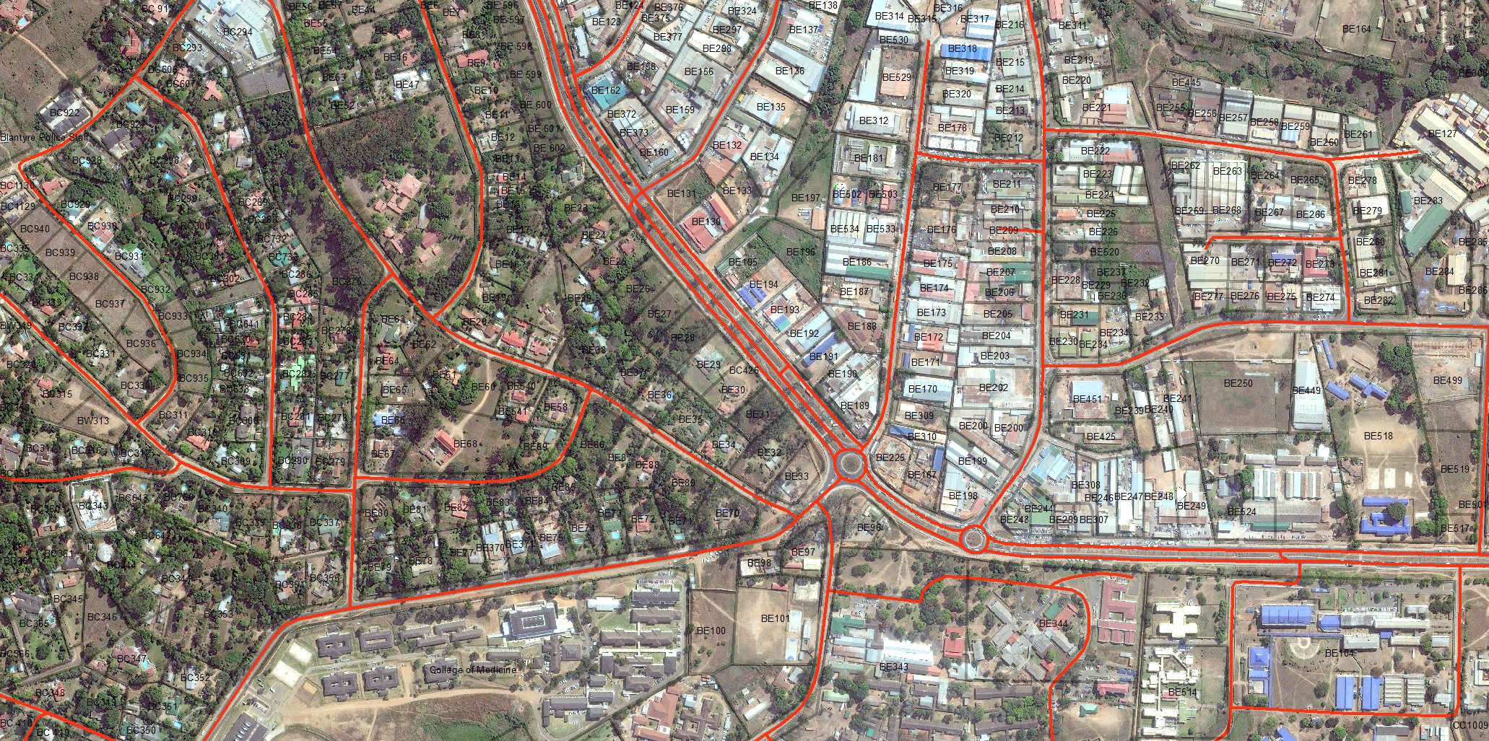
Satellite imagery, Part of Ranchi City, (Source: JSAC)

Slide 16
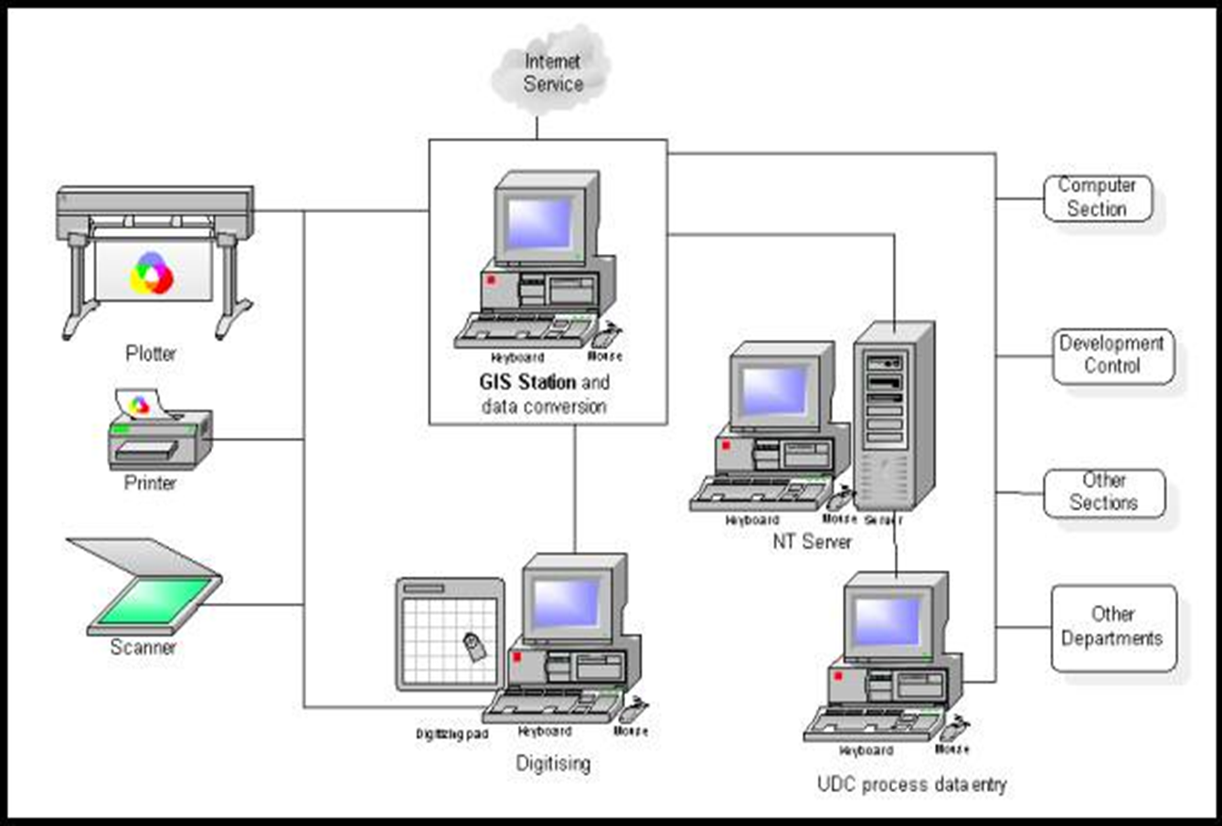

Slide 17
Now questions are arriving, how we can use geospatial techniques on urban landscape?
How these techniques can be used in developing countries to improve urban land use management
How remote sensing can help in urban sprawl study
Utilizing remote sensing to determine land suitability analysis in urban development control

Slide 18
Preparation of land use maps
Study of urban sprawl
Land suitability analysis
Infrastructure planning

Slide 19
Solid waste management
Development control compliance
Urban renewal
Disaster mitigation measures
Interfacing with expert system

Slide 20
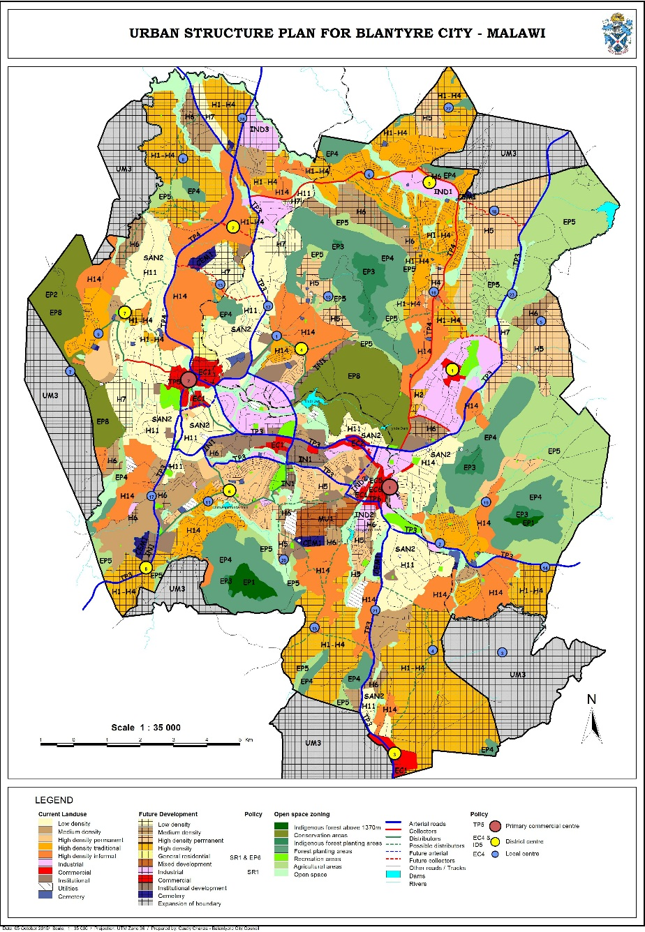
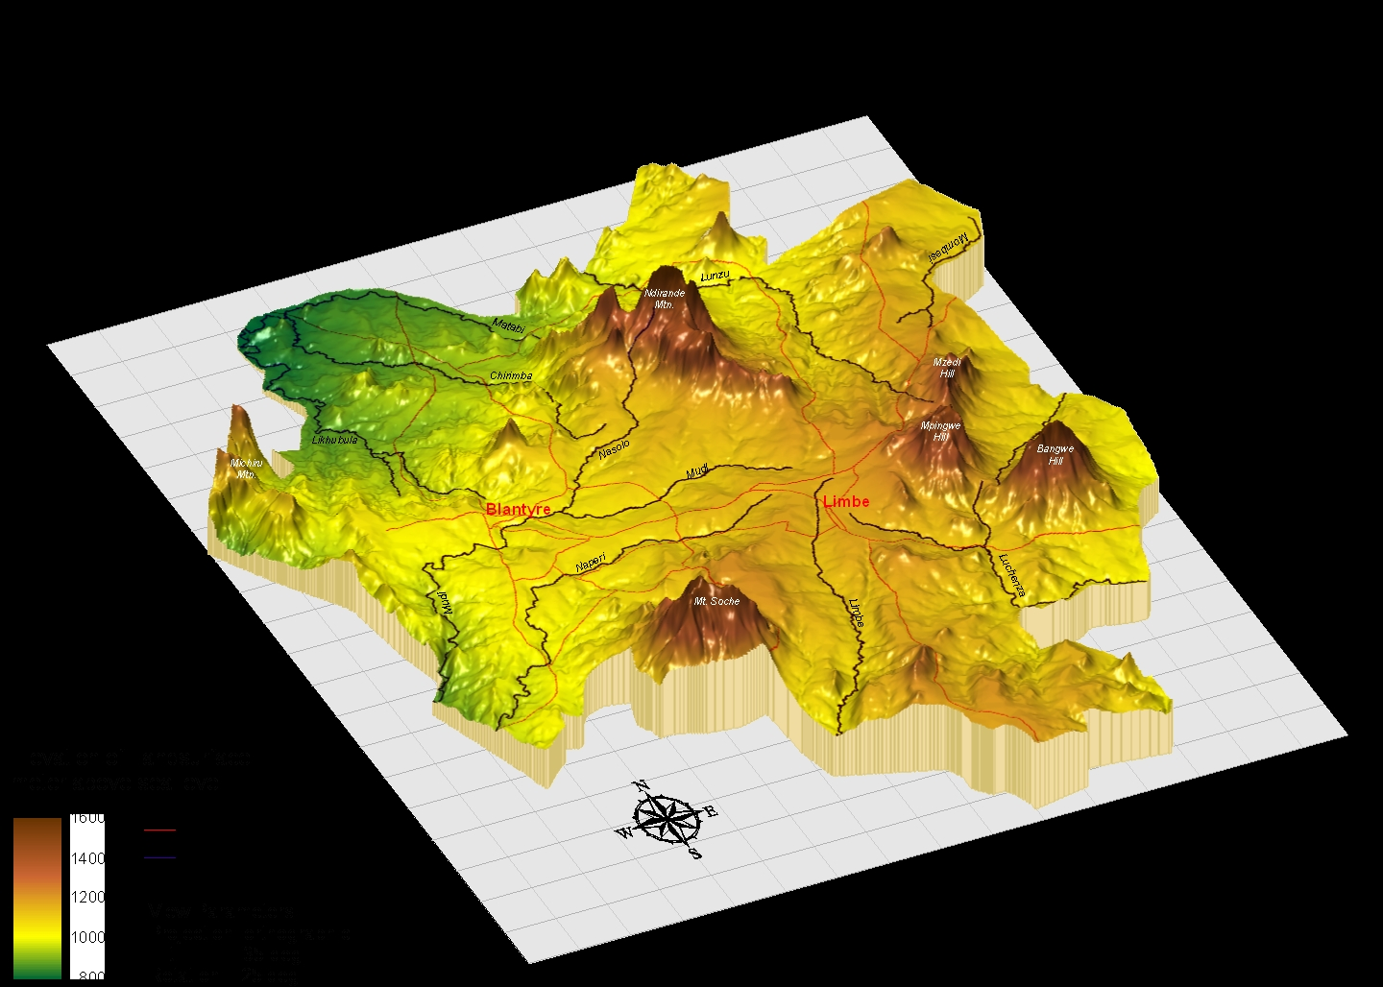
GIS applications in municipal development planning system
Urban
Structure
Plan
Topographic
map

Slide 21
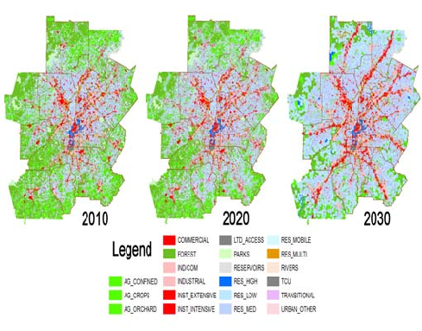
Study of Urban Sprawl and Growth Trends :
Since satellite based remote sensing systems have unique capability to provide repetitive coverage for any pay of the world.
this makes it most suitable for monitoring and updating of urban expansion by using very high resolution multi-temporal remote sensing data especially for town and country planning.

Slide 22
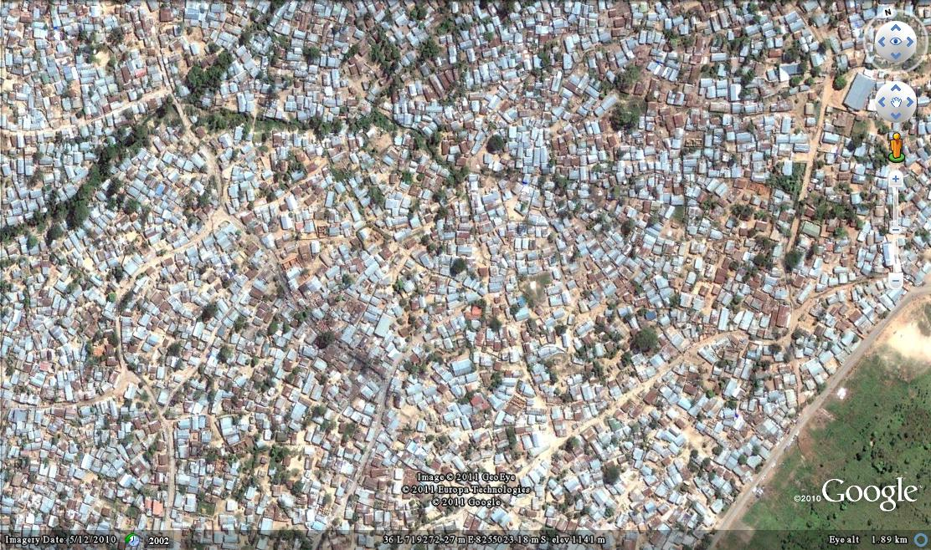
Urban sprawl
study

Slide 23
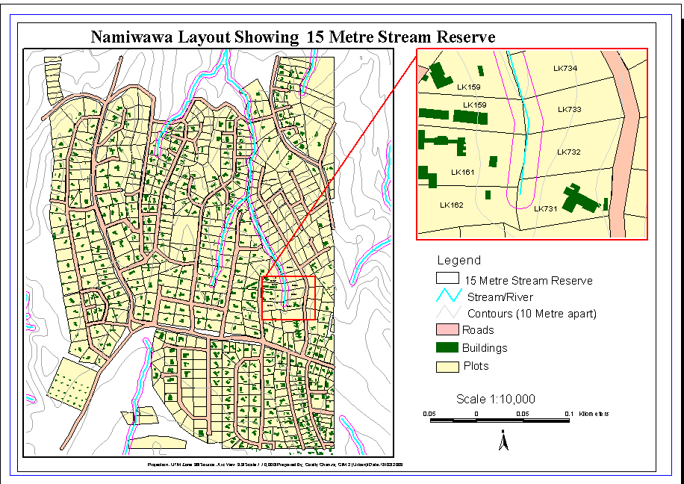
Development
Control
compliance
Road
infrastructure

Slide 24
Space Use in the Core Area :
From the monitoring point of view of city area, information about land use only may not be sufficient for city administrators and planners in congested core areas.
The true picture may only be visualized from available information on actual space use. Space, however defined, has a location, and data necessarily refer to a point in time. In the absence of suitable large scale maps for such detailed studies, the principal use of very high resolution (i.e. IKONOS) satellite data provide a base for the survey/ recording of various activities in the field.
The rest were confirmed/ picked up during the field visit.
Quantitative determination of space use allows in understanding the distribution pattern of various activities and functional characteristics within urban fabric, which is useful for quantifying the stress on existing infrastructure.

Slide 25
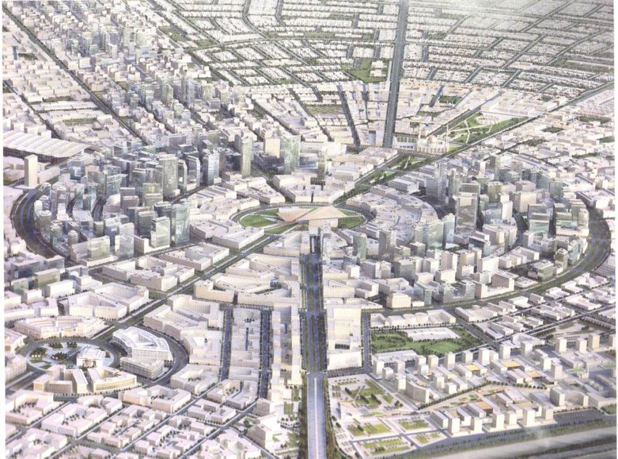
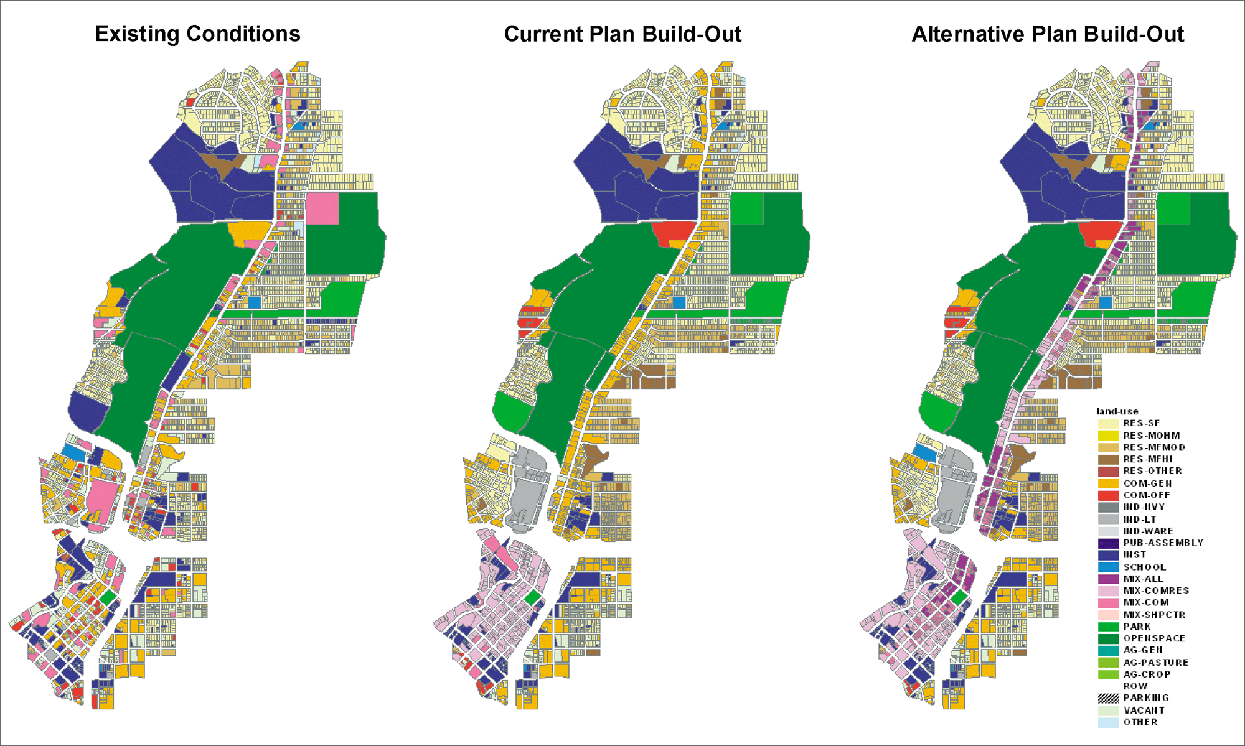
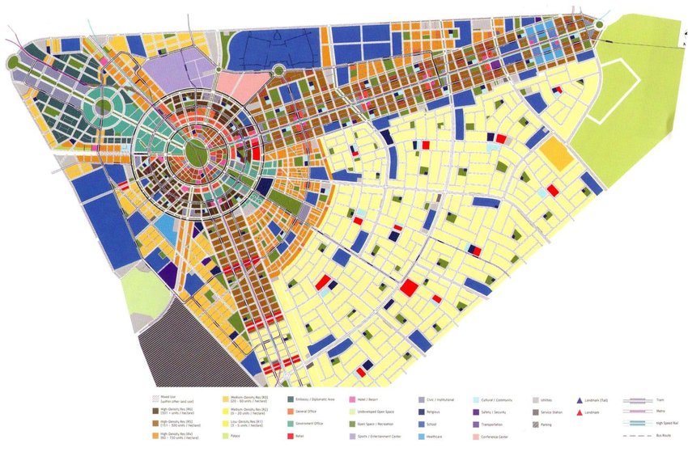
Space Use in the Core Area :

Slide 26
Travel Route Pattern :
Physical infrastructure of an urban center comprises of transportation, water supply, electric power supply, sewage etc.
The transportation system is one of the keys to rapid modernization, particularly in developing countries. Irrespective of whether roads act as a catalyst for development or play a more passive role in development, it is necessary to work out a judicious plan so as to avoid congestion, pollution and cost.
The main objective of this type of studies using Remote Sensing and GIS techniques is to make network analysis of tourist places considering two factors: time and cost.
This type of study provides a methodology for analyzing the optimum transportation network of tourist cities, and can be very helpful when planning for other cities also.

Slide 27
Green spaces in cities exist mainly as semi-natural areas, managed parks and gardens, supplemented by scattered vegetated pockets associated with roads and incidental locations.
The role of remote sensing in the case of green / open spaces mapping and analysis has become important for managing, and maintenance of old and degraded spaces.
However, in a number of cases remote sensing can supple mentor partially replace tedious ground survey methods. Moreover, ground methods have limitations as whole area may not be accessed in one go and information collected may not be as accurate as possible through remote sensing, aided by limited ground survey.
Urban Environment Analysis :
Remote sensing not only provides spatial data but also allows us to compare temporal variations in spatial data, which is essential for green/open spaces management.

Slide 29
A triangulated irregular network (TIN) - digital data structure used in a geographic information system (GIS) for the representation of a surface.
Site suitability
analysis

Slide 30
Site Suitability Analysis :
A number of workers have identified various criteria including soils, hydrology, topography, vegetation, climate, existing built up areas, transportation route etc. to find out suitable sites for location of development activities.
The most commonly technique for suitability analysis is weighted suitability method.
Weighted suitability is more complex; in order not to bias the weighting the aspect scales should first be normalized that is used in the same numerical range.

Slide 31
GIS integration

Slide 32
Social Infrastructure :
In most Indian cities, the municipal bodies have primary responsibility to cater to the basic needs of the citizen by providing required essential services and infrastructure facilities.
But during the last century, cities throughout the developing world have seen an extraordinary increase in their population size, which has put tremendous strain on the delivery of the basic infrastructure services.
A major concern of municipalities in developing countries is the limited access to urban services of larger parts of the city population Equitable distribution is becoming the center of concern in planning the infrastructure facilities.
There is an urgent need to solve this problem of unbalanced distribution of infrastructure services. The social infrastructure facilities basically include banks, post-office, schools, medical facilities, etc. For each facility the proposed indicators are : (a) Number of facility/Total population of the ward, (b) Number of facility/Total area of the ward

Slide 33
Concluding Remarks
Remote sensing can help in urban sprawl study.
Remote sensing can determine land suitability analysis in urban development control.
The proposal can be a launch pad for further full fledged development of GIS in a municipal council when resources have been identified.
GIS and Remote Sensing technologies have capability to provide necessary physical input and intelligence for preparation of base maps, formulation of planning proposals and act as monitoring tool during implementation phases of the development plans and projects.

